Slide 1

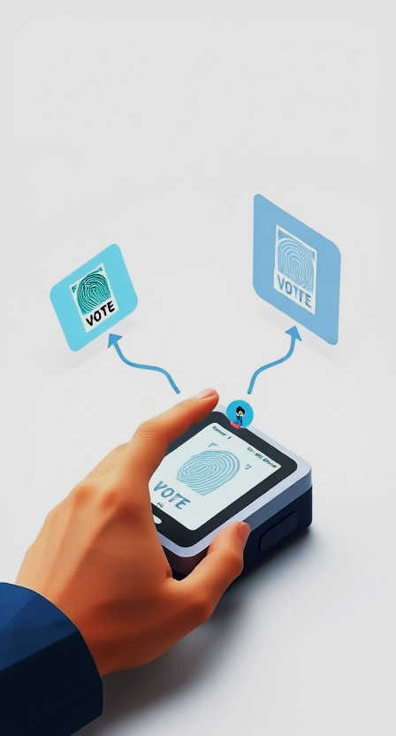
Decentralized Biometric Authentication Voting System
“A Secure, Transparent, and Reliable Voting System”
– Tushar Bhos
DIV - A

Slide 2
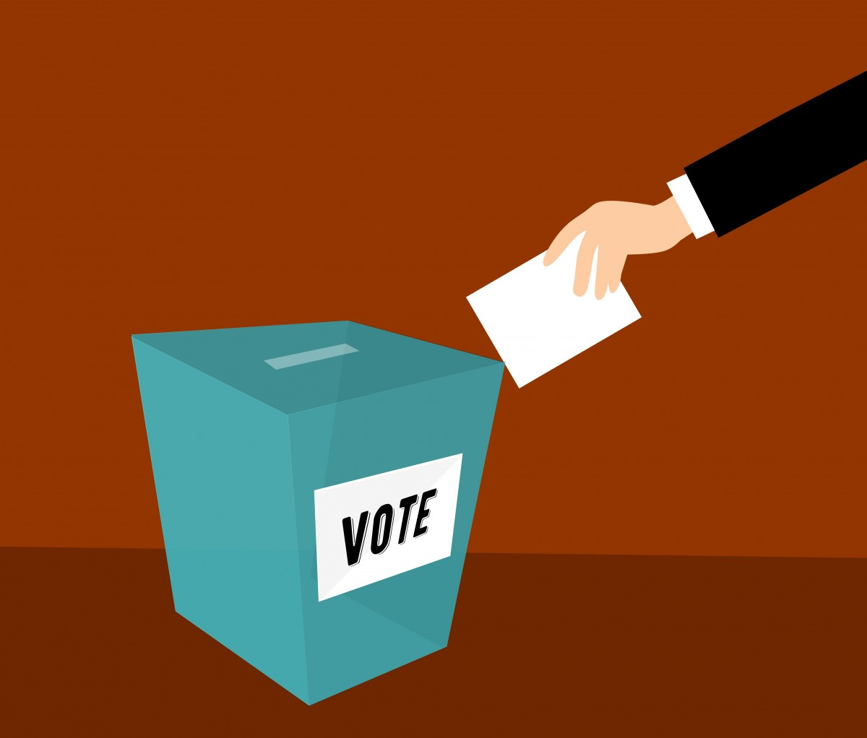
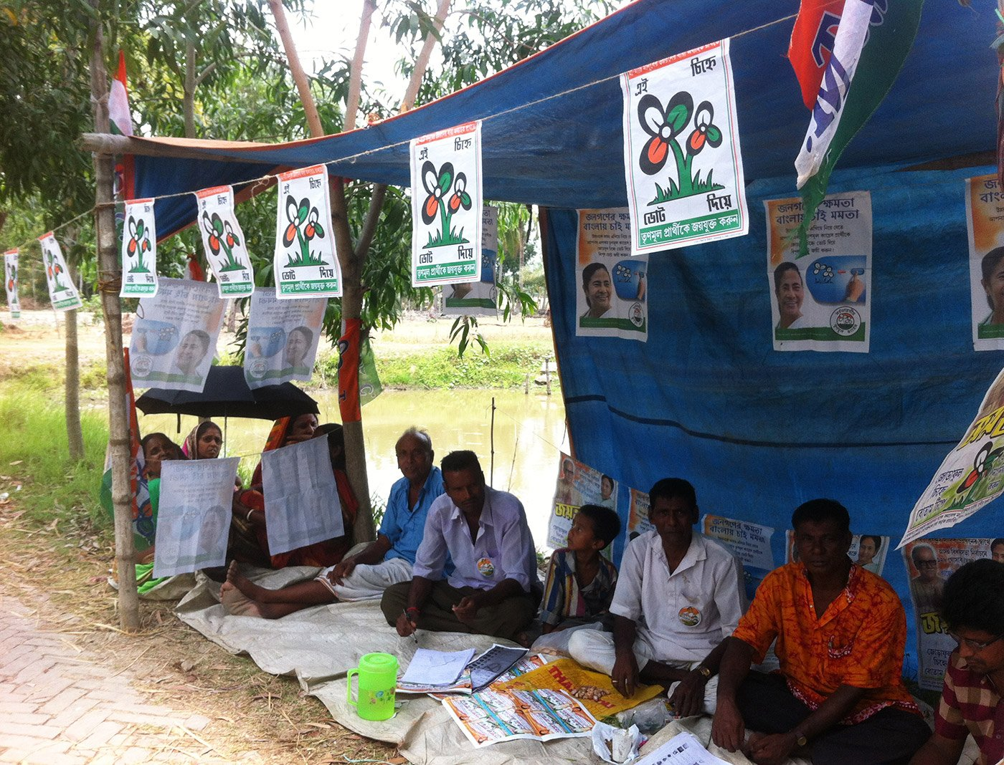
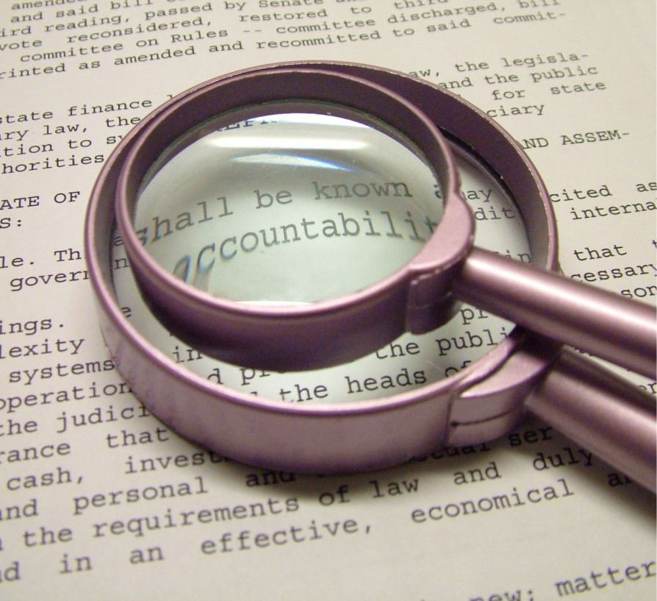
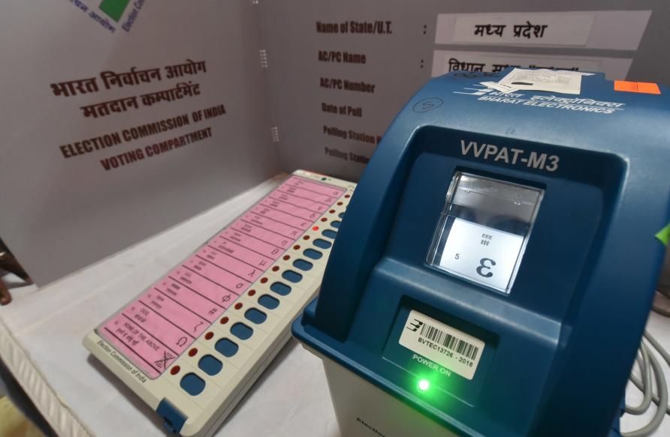


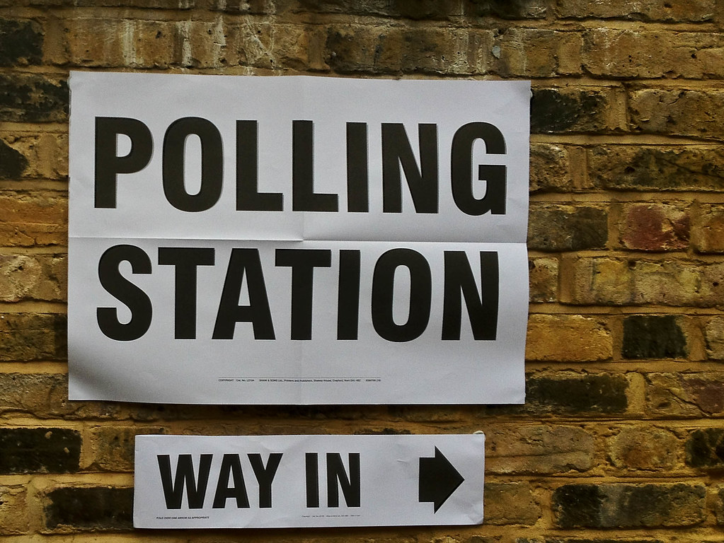


“Challenges in current voting systems”
Risk of voter fraud and double voting.
Limited access for remote voters.
Lack of transparency and security and Accountability.
Potential tampering with Electronic Voting Machines (EVMs).
High Costs and Inefficiency.
Privacy Concerns.
Polling Booth Tampering.
Identity Verification Challenges.
Logistical Challenges in Large Elections.

Slide 3
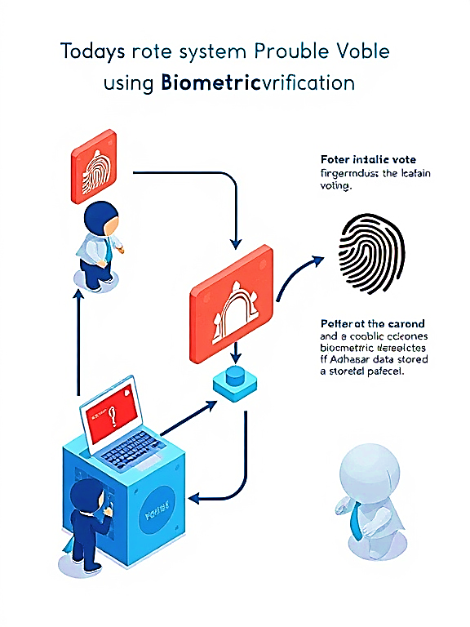
“Why this project is necessary”
Ensuring Electoral Integrity
  Prevent electoral malpractices like fake voting, booth capturing, and double voting.
  Build trust among citizens by guaranteeing fair and secure elections.
Improving Voter Turnout
  Simplify the voting process for citizens, including those living in remote areas or overseas (e.g., NRIs).
  Offer a seamless and accessible voting experience to encourage higher participation.
Leveraging Aadhaar-Based Biometrics
  Use Aadhaar-linked biometrics for robust voter authentication.
  Address issues related to identity mismatches in voter databases.
Reducing Administrative and Logistical Costs
  Minimize the need for physical polling booths, paper ballots, and manual processes.
  Reduce the burden on election staff while increasing efficiency.
Enhancing Transparency
  Implement blockchain technology to create an auditable and tamper-proof system.
  Ensure that every vote is securely recorded and cannot be altered or deleted.
Eliminating Geographical Barriers
  Enable remote and online voting options for citizens in different states or countries.
  Make elections more inclusive for the elderly, differently-abled, and those in geographically inaccessible regions.
Data Privacy and Security
  Protect voter information from misuse or breaches through advanced encryption and decentralized storage.
  Ensure voter anonymity to safeguard the democratic process.
Speeding Up Election Results
  Automate the vote counting process to deliver faster, more accurate results.
  Eliminate manual errors during counting and reduce delays in declaring results.

Slide 4
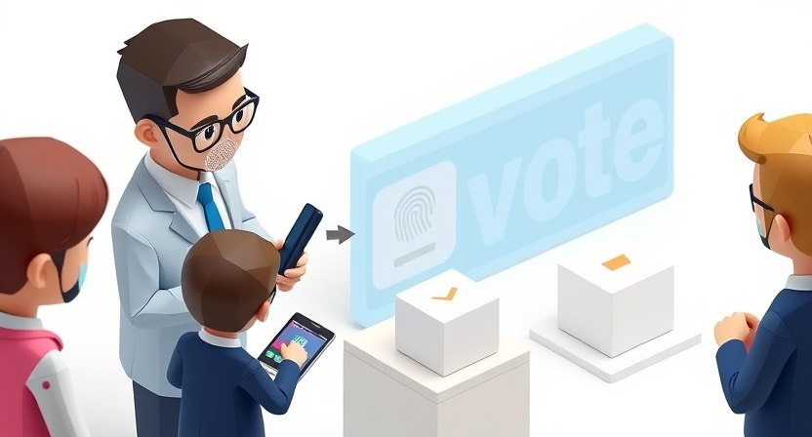
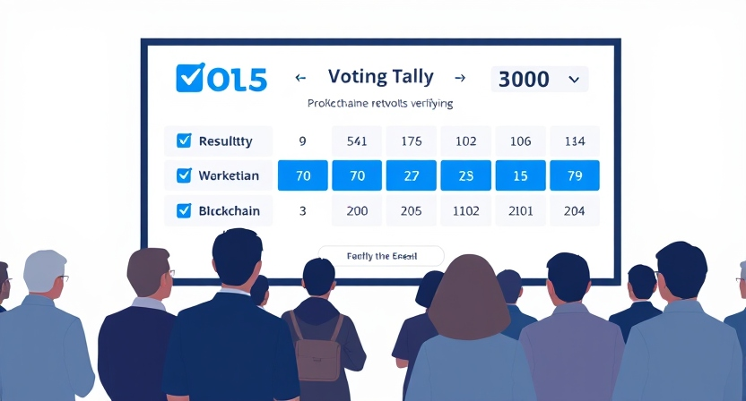
“Primary Users, Government Entities, Remote and Migrant Voters, And Secondary Users”
Primary Users:
  Citizens of the country who are legally eligible to vote.
  Includes individuals in urban, rural, and remote areas.
Government Entities:
  Election Commission of India (ECI):
    Simplifies voter registration and verification processes.
    Provides a secure system for conducting elections with transparency.
  Polling Staff and Administrators:
    Reduces their workload by automating authentication and vote counting.
Security Agencies:
  To monitor and prevent any potential cyber threats or system misuse during elections.
  Polling Staff and Administrators:
    Reduces their workload by automating authentication and vote counting.
Secondary Users:
  Technical Developers and Researchers:
    Utilize the project as a framework to build or enhance similar systems globally.
  Policy Makers and Legislators:
    Use data insights to improve the electoral process.
  Election Observers:
    Conduct real-time audits to ensure fairness and transparency.

Slide 5
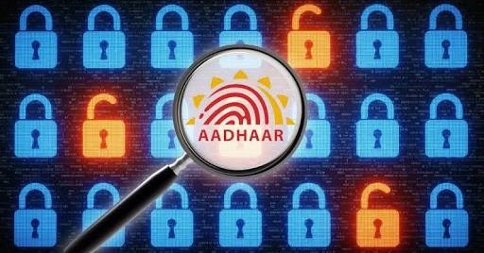
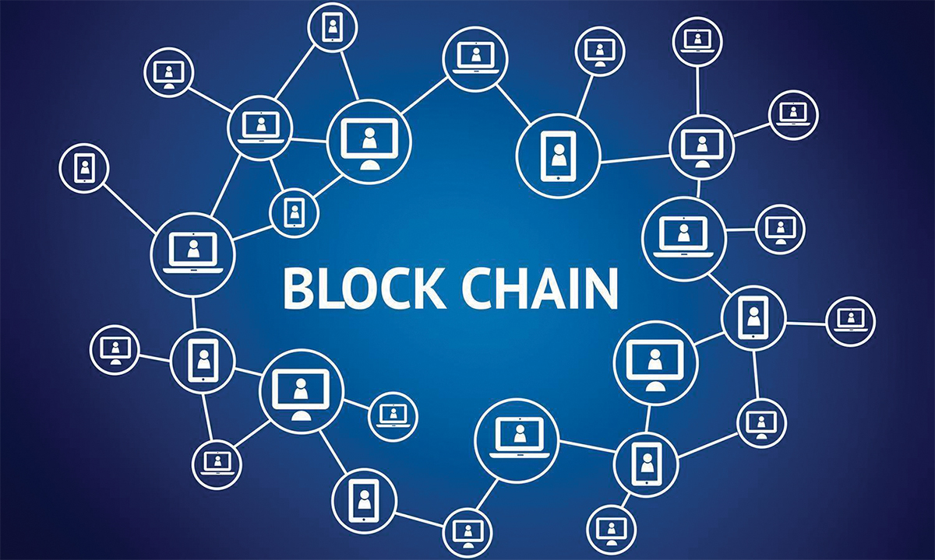
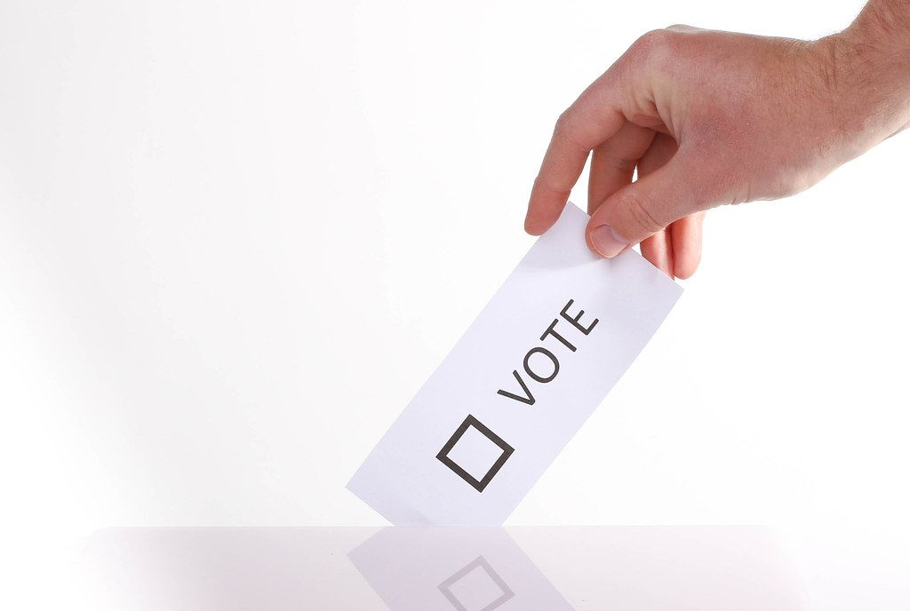

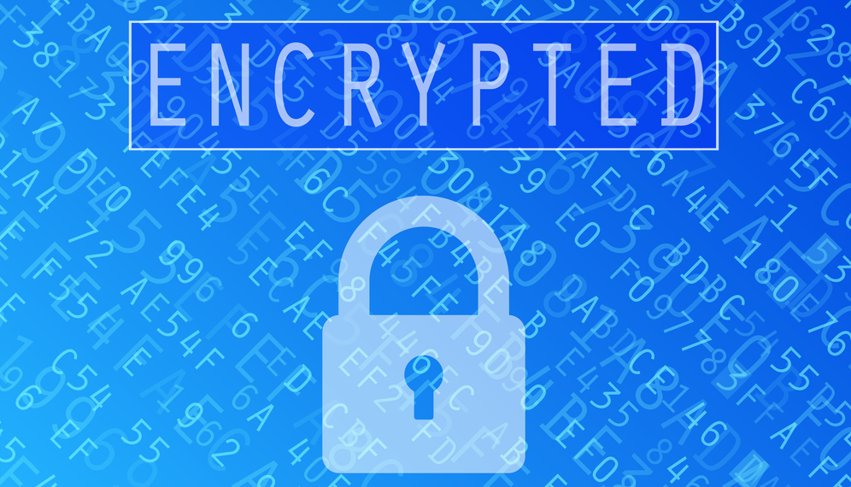
“Proposed System: Biometric-Based Decentralized Voting System”
Aadhaar-Integrated Biometric Verification:
  Ensures secure voter authentication using Aadhaar-linked fingerprints, iris scans, and face recognition.
  Resolves common issues like mismatched voter IDs and fraudulent voter impersonation.
  If a fingerprint fails, alternative biometrics such as an iris scan or face ID can be used for verification.
Decentralized Blockchain Technology:
  Immutable Records: Every vote is stored in a blockchain ledger that cannot be tampered with.
  Transparency: Allows the Election Commission to audit and verify votes without compromising voter privacy.
  Anonymity: Ensures that individual voter identities remain confidential while securing their participation in elections.
Double Voting Prevention:
  Aadhaar-based biometric validation ensures that a voter can only cast one vote.
  If a voter attempts to cast a second vote, the system identifies and blocks it automatically, preserving the integrity of the election.
Migrant Citizens Voting Accessibility:
  Enables remote and online voting for:
    Migrant workers who are far from their hometowns.
    Citizens residing abroad or in hard-to-reach areas.
    Disabled or elderly voters who cannot travel to polling booths.
End-to-End Encryption:
  Ensures that data transmitted between the voter, the system, and the blockchain ledger is fully secure.
  Protects against cyber threats, hacking attempts, or unauthorized access to voter data.

Slide 6
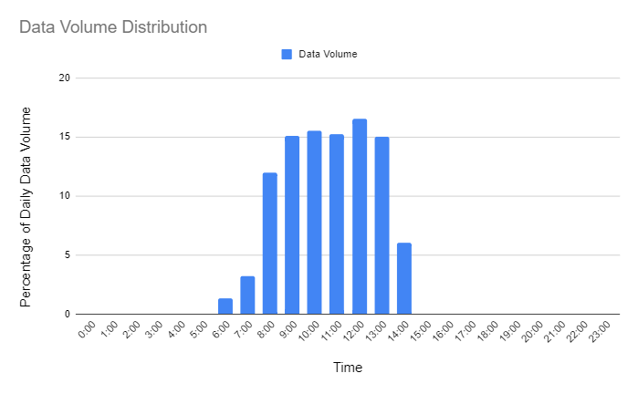


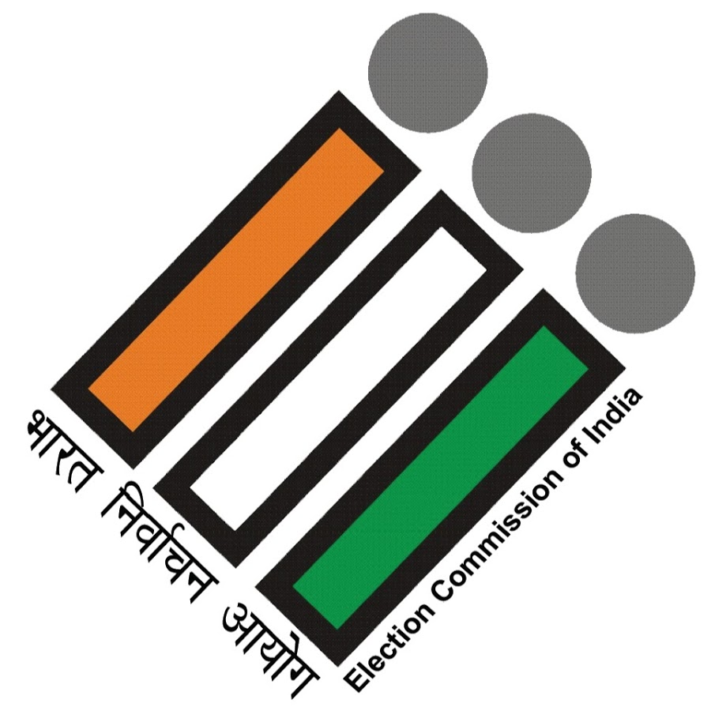
Real-Time Validation and Result Generation:
  Votes are recorded and validated in real-time on the blockchain.
  Election results are automatically calculated without manual intervention, reducing delays.
Environmental Sustainability:
  Eliminates the need for paper ballots, reducing the carbon footprint of elections.
  Digital records replace manual paperwork for faster processing.
Customizable Security Features for Country:
  Geofencing to restrict votes to registered constituencies.
  Automatic detection and reporting of suspicious activities or tampering attempts.
Scalability for Nationwide Elections:
Designed to handle the scale and diversity of India’s massive electoral process.
Ensures seamless voting even during large-scale national elections.

Slide 7
“Prototype Features, Workflow Diagram and Technology Stack”
”
Prototype Features:
Aadhaar-Linked Biometric Authentication:
  Uses fingerprint, iris, and face recognition for secure and accurate voter verification.
  Multiple biometric options ensure seamless authentication even if one method fails.
Blockchain-Based Voting System:
  Records votes in a tamper-proof, decentralized blockchain ledger.
  Guarantees data integrity, transparency, and real-time validation of votes.
Fraud Prevention Mechanism:
  Detects and blocks attempts at duplicate voting using Aadhaar biometrics.
  Maintains voter anonymity to ensure privacy and protect identities.
High-Level Data Security:
  End-to-end encryption protects voter data and prevents cyber threats.
  Ensures that both identity and votes are securely stored.
Transparency and Auditability:
  Allows election authorities to audit the voting process without exposing voter identities.
  Builds trust by providing a verifiable, tamper-proof election record.

Slide 8


Workflow Diagram:
Voter Registration
Biometric Authentication
Aadhaar Database Verification
Access to Voting Portal
Cast Vote
Voter registers their biometric data (fingerprint, iris, and face) linked to Aadhaar during the registration process.
Voter verifies their identity at the polling booth or through the app by providing biometrics.
Multiple options like fingerprint, iris scan, or face recognition ensure fallback mechanisms.
Biometric data is cross-checked with the Aadhaar database to verify voter identity in real time.
Ensures that only legitimate voters can proceed.
Upon successful verification, voter gets access to the decentralized blockchain-based voting portal.
Access granted with secure encryption protocols.
Voter selects their choice on the blockchain portal and submits the vote.
Vote is encrypted and anonymized for security.

Slide 9
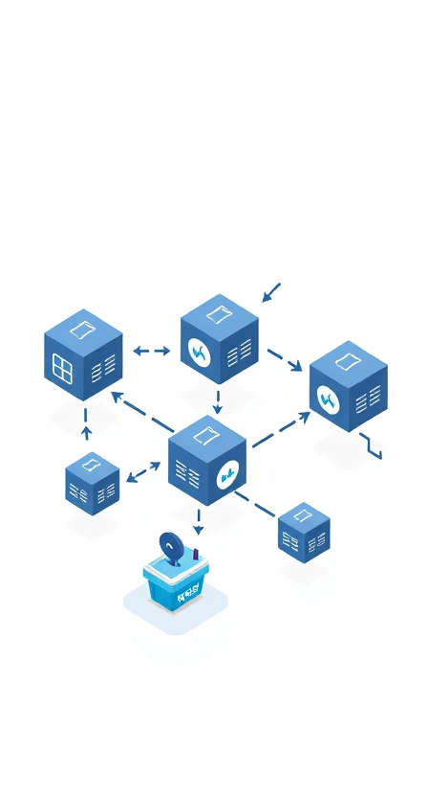
Vote Validation
Blockchain Storage
Election Monitoring
Result Compilation and Publishing
The submitted vote is validated by the blockchain ledger to ensure authenticity.
Tamper-proof records are created, and double voting is prevented.
The validated vote is stored in a decentralized blockchain ledger.
Immutable records ensure transparency and security.
Election officials can monitor and audit the voting process without exposing individual voter data.
Ensures trust and transparency in the system.
Votes are automatically tallied, and results are generated securely.
Results are made public without compromising voter anonymity.
Secure Process.
Immutable Blockchain Ledger. Tamper-Proof System.

Slide 10

“Technology Stack”
Frontend Development:
  React.js: For building an intuitive and responsive user interface for web-based access.
  Flutter: For developing a secure and cross-platform mobile application.
Backend Development:
  Node.js: For handling authentication, request processing, and data management.
  Express.js: Lightweight and secure backend framework for API handling.
Blockchain Technology:
  Ethereum Blockchain: Decentralized ledger for recording and securing votes.
  Hyperledger Fabric: Private blockchain network for high security and controlled access.
  Smart Contracts: Ensure transparent and automated vote validation and storage.
Biometric Verification:
  Aadhaar APIs: For integrating fingerprint, iris, and face recognition with the national database.
  Neurotechnology SDK: For advanced biometric authentication algorithms.
Database Management:
  MongoDB: NoSQL database for storing encrypted logs and metadata.
  IPFS (InterPlanetary File System): For decentralized storage of critical data.
Encryption and Security:
  TLS 1.3: For secure communication between clients and servers.
  SHA-256: For encrypting sensitive data like votes and user credentials.
  Zero-Knowledge Proofs: To maintain voter anonymity while verifying authenticity.
Cloud Services:
  AWS (Amazon Web Services): For hosting decentralized infrastructure and ensuring scalability.
  Microsoft Azure: For blockchain integration and secure data processing.
Monitoring and Auditing Tools:
  Splunk: For real-time system monitoring and anomaly detection.
  Grafana: For visualizing the system's operational data.

Slide 11
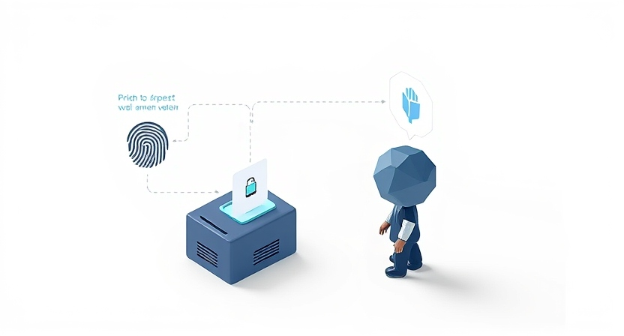
“Summary, Impact and Future Scope”
  A secure and transparent voting system integrating biometrics, Aadhaar, and blockchain.
  Eliminates risks like voter fraud, double voting, and data tampering.
  Builds trust and ensures fairness in the election process.
  Scalable and efficient solution for large-scale national elections.
  AI/ML for fraud detection.
  Integration with global decentralized ID systems.
  Enhanced biometric technologies for faster authentication.

Slide 12


